Slide 1

MODULE 5
Operating System Security
Tanenbaum, Modern Operating Systems 3 e, (c) 2008 Prentice-Hall, Inc. All rights reserved. 0-13-6006639

Slide 2
Protection Mechanisms
Security is easier to achieve if there is a clear model of what is to be protected and who is allowed to do what.
Tanenbaum, Modern Operating Systems 3 e, (c) 2008 Prentice-Hall, Inc. All rights reserved. 0-13-6006639

Slide 3

5.1 Protection Domains
A computer system contains many "objects" that need to be protected. Objects can be
Hardware- CPUs, memory segments, disk drives, or printers
Software- Processes, files, databases, or semaphores.
Each object has a unique name by which it is referenced, and a finite set of operations that processes are allowed to carry out on it.
eg:-read and write operations to a file; up and down on a semaphore.

Slide 4
A way is needed to prohibit processes from accessing objects that they are not authorized to access.
This mechanism must also make it possible to restrict processes to a subset of the legal operations when that is needed.
eg:-process A may be entitled to read, but not write, file F

Slide 5
Domain is a set of (object, rights) pairs. Each pair specifies an object and some subset of the operations that can be performed on it.
right - means permission to perform one of the operations.
Often a domain corresponds to a single user, telling what the user can do and not do, but a domain can also be more general than just one user.
eg:- the members of a programming team working on some project might all belong to the same domain so that they can all access the project files.

Slide 6
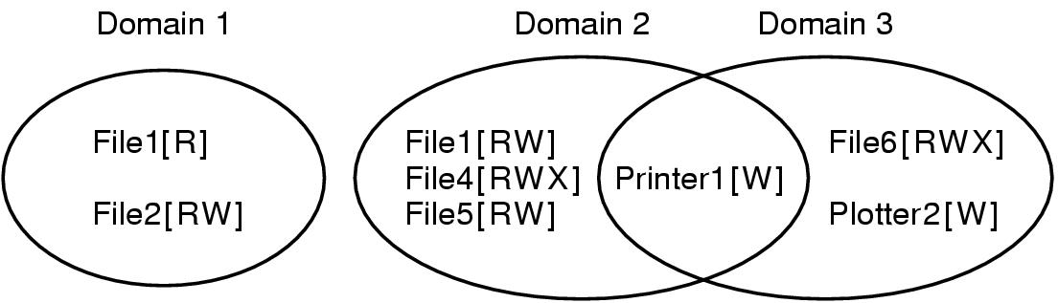
Protection Domains (1)
Figure 9-4. Three protection domains.
Tanenbaum, Modern Operating Systems 3 e, (c) 2008 Prentice-Hall, Inc. All rights reserved. 0-13-6006639

Slide 7
In UNIX, the domain of a process is defined by its UID and GID.
Given any (UID, GID) combination, it is possible to make a complete list of all objects (files, including I/O devices represented by special files, etc.) that can be accessed, and whether they can be accessed for reading, writing, or executing.
Processes with the same (UID, GID) combination- have access to exactly the same set of objects.
Processes with different (UID, GID) values - have access to a different set of files, although there may be considerable overlap.

Slide 8
Each process in UNIX has two halves: the user part and the kernel part.
When the process does a system call, it switches from the user part to the kernel part.
The kernel part has access to a different set of objects from the user part.

Slide 9
The system keeps track of which object belongs to which domain by a large matrix, with the rows being domains and the columns being objects.
Each box lists the rights, if any, that the domain contains for the object.

Slide 10
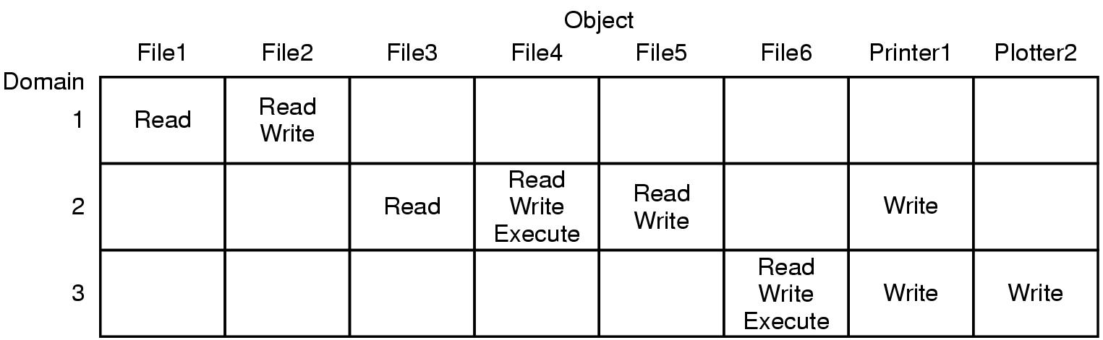
Protection Domains (2)
Figure 9-5. A protection matrix.
Tanenbaum, Modern Operating Systems 3 e, (c) 2008 Prentice-Hall, Inc. All rights reserved. 0-13-6006639

Slide 11
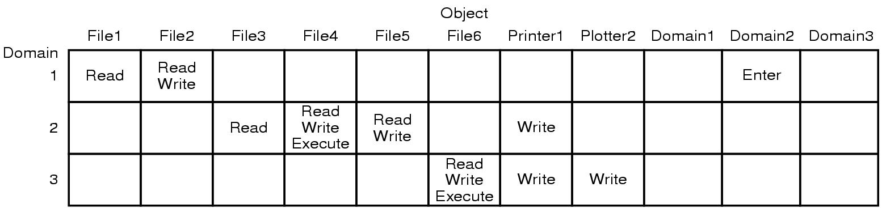
Protection Domains (3)
Domain switching itself can be easily included in the matrix model by realizing that a domain is itself an object, with the operation enter.
Figure 9-6. A protection matrix with domains as objects.
Tanenbaum, Modern Operating Systems 3 e, (c) 2008 Prentice-Hall, Inc. All rights reserved. 0-13-6006639

Slide 12
Storing the matrix is rarely done because it is large and sparse.
Most domains have no access at all to most objects, so storing a
very large, mostly empty, matrix is a waste of disk space.
Two methods that are practical,
storing the matrix by row - capability list
storing the matrix by columns - access control list
Storing only the non-empty elements

Slide 13
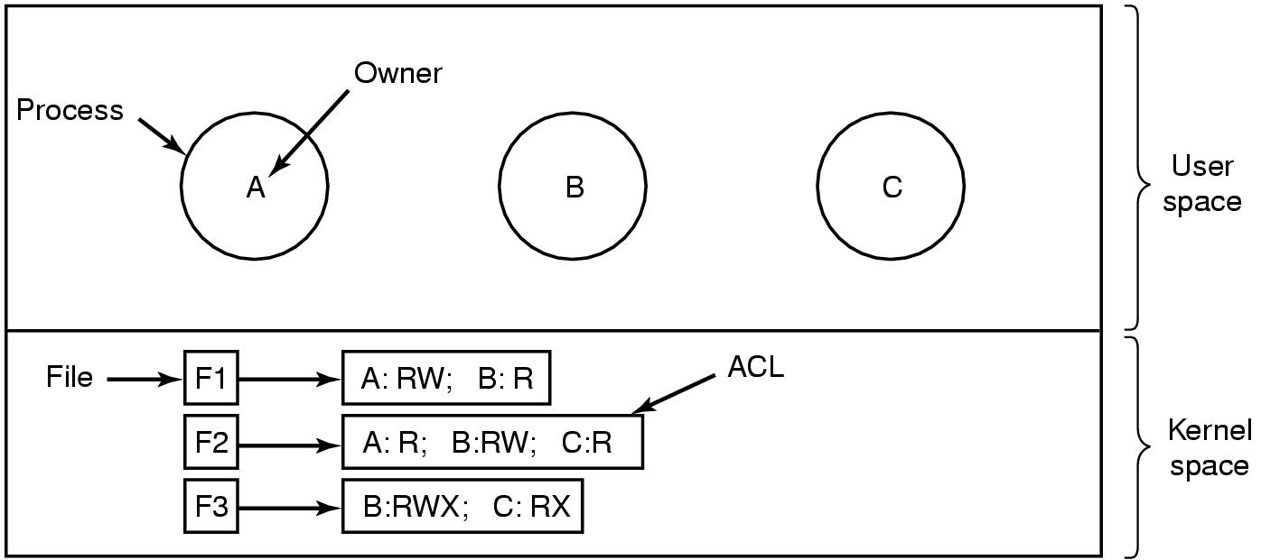
Access Control Lists (1)
The technique consists of associating with each object an (ordered) list containing all the domains that may access the object, and how. This list is called the Access Control.List (or ACL)
Figure 9-7. Use of access control lists to manage file access.
Tanenbaum, Modern Operating Systems 3 e, (c) 2008 Prentice-Hall, Inc. All rights reserved. 0-13-6006639

Slide 14
We have only shown three rights so far: read, write, and execute. There may be additional rights as well.
generic - apply to all objects ,eg:-destroy object and copy object
object specific ,eg:- append message for a mailbox object and sort alphabetically for a directory object.
Note :- the rights are granted by user, not by process.

Slide 15
Many systems support the concept of a group of users. Groups have names and can be included in ACLs.
Two variations on the semantics of groups are possible.
In some systems , each process has a user ID (UID) and group ID (GID). In such systems, an ACL entry contains entries of the form
UID1, G I D 1 : rightsl; UID2, G I D 2 : rights2;...
Under these conditions, when a request is made to access an object, a check is made using the caller's UID and GID. If they are present in the ACL, the rights listed are available. If the (UID, GID) combination is not in the list, the access is not permitted.

Slide 16
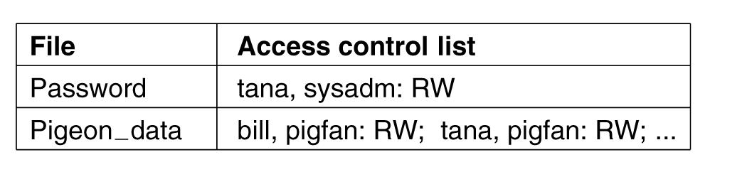
Access Control Lists (2)
Using groups this way effectively introduces the concept of a role.
Figure 9-8. Two access control lists.
If Tana tries to access one of these files, the result depends on which group she is currently logged in as. The point of this scheme is to prevent Tana from accessing the password file when she currently has her pigeon fancier's hat on. She can only do that when logged in as the system administrator.
Tanenbaum, Modern Operating Systems 3 e, (c) 2008 Prentice-Hall, Inc. All rights reserved. 0-13-6006639

Slide 17
In some cases, a user may have access to certain files independent of which group she is currently logged in as. That case can be handled by introducing the concept of a wildcard, which mean everyone.eg:-
tana, *: RW
The entry for the password file would give Tana access, no matter which group she was currently in as.
Another possibility is that if a user belongs to any of the groups that have certain access rights, the access is permitted.
Adv:-a user belonging to multiple groups does not have to specify which group to use at login time.
Disadv:-provides less encapsulation:

Slide 18
The use of groups and wildcards introduces the possibility of selectively blocking a specific user from accessing a file.eg:-, the entry
virgil, *: (none); *, *: RW
gives the entire world except for Virgil read and write access to the file.
This works because the entries are scanned in order, and the first one that applies is taken; subsequent entries are not even examined.

Slide 19
The other way of dealing with groups is not to have ACL entries consist of (UID, GID) pairs, but to have each entry be a UID or a GID. For example, an entry for the file pigeon—data could be
debbie: RW; phil: RW; pigfan: RW
It sometimes occurs that a user or a group has certain permissions with respect to a file that the file owner later wishes to revoke . All that has to be done is edit the ACL to make the change.
However, if the ACL is checked only when a file is opened, most likely the change will only take effect on future calls to open.
Any file that is already open will continue to have the rights it had when it was opened, even if the user is no longer authorized to access the file.

Slide 20
Capabilities
The other way of slicing up the protection matrix is by rows.
When this method is used, associated with each process is a list of objects that may be accessed, along with an indication of which operations are permitted on each, in other words, its domain. This list is called a capability list (or C-Iist) and the individual items on it are called capabilities

Slide 21
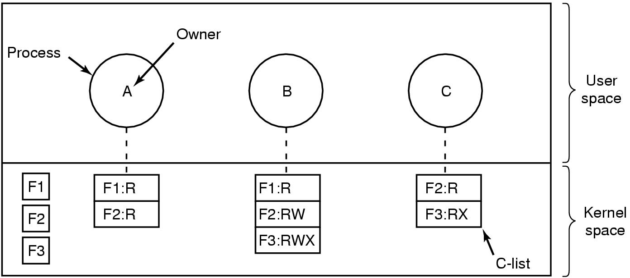
Capabilities (1)
Figure 9-9. When capabilities are used,
each process has a capability list.
Each capability grants the owner certain rights on a certain object. In Fig. 9-9, the process owned by user A can read files Fl and F2
Tanenbaum, Modern Operating Systems 3 e, (c) 2008 Prentice-Hall, Inc. All rights reserved. 0-13-6006639

Slide 22
It is fairly obvious that capability lists must be protected from user tampering .
Three methods of protecting them are known.
Requires a tagged architecture, a hardware design in which each memory word has an extra (or tag) bit that tells whether the word contains a capability or not. The tag bit is not used by arithmetic, comparison, or similar ordinary instructions, and it can be modified only by programs running in kernel mode (i.e., the operating system).
Eg:- IBM AS/400

Slide 23
Capabilities (2)
To keep the C-list inside the operating system. Capabilities are then referred to by their position in the capability list. A process might say:"Read 1 KB from the file pointed to by capability 2.”
Eg:- Hydra
The third way is to keep the C-list in user space, but manage the capabilities cryptographically so that users cannot tamper with them.
Figure 9-10. A cryptographically protected capability.
Tanenbaum, Modern Operating Systems 3 e, (c) 2008 Prentice-Hall, Inc. All rights reserved. 0-13-6006639

Slide 24
Capabilities (3)
Examples of generic rights:
Copy capability: create a new capability for the same object.
Copy object: create a duplicate object with a new capability.
Remove capability: delete an entry from the C-list; object unaffected.
Destroy object: permanently remove an object and a capability.
Tanenbaum, Modern Operating Systems 3 e, (c) 2008 Prentice-Hall, Inc. All rights reserved. 0-13-6006639

Slide 25
ACLs and capabilities have somewhat complementary properties.
Capabilities are very efficient because if a process says "Open the file pointed to by capability 3" no checking is needed. With ACLs, a (potentially long) search of the ACL may be needed.
Capabilities also allow a process to be encapsulated easily, whereas ACLs do not.
On the other hand, ACLs allow selective revocation of rights, which capabilities do not.
If an object is removed and the capabilities are not or the capabilities are removed and an object is not, problems arise. ACLs do not suffer from this problem.

Slide 26
Trusted Systems
Consider reports of viruses, worms, etc.
Two naive (but logical) questions:
Is it possible to build a secure computer system?
If so, why is it not done?
Current systems are not secure but users are unwilling to throw them out.
The only known way to build a secure system is to keep it simple. Features are the enemy of security.
Tanenbaum, Modern Operating Systems 3 e, (c) 2008 Prentice-Hall, Inc. All rights reserved. 0-13-6006639

Slide 27
Trusted Computing Base
At the heart of every trusted system is a minimal TCB (Trusted Computing Base) consisting of the hardware and software necessary for enforcing all the security rules.
The TCB typically consists of most of the hardware (except I/O devices that do not affect security), a portion of the operating system kernel, and most or all of the user programs that have superuser power (eg., SETUID root programs in UNIX).
In a secure design, often the TCB will be quite separate from the
rest of the operating system in order to minimize its size and verify its correctness.

Slide 28
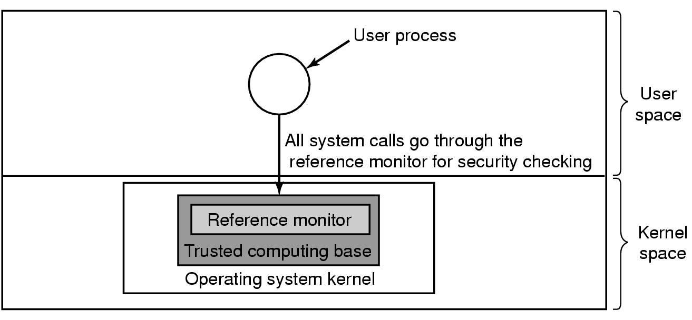
Trusted Computing Base
Figure 9-11. A reference monitor.
Tanenbaum, Modern Operating Systems 3 e, (c) 2008 Prentice-Hall, Inc. All rights reserved. 0-13-6006639

Slide 29
Formal Models of Secure Systems
Protection matrices, are not static. They frequently change as new objects are created, old objects are destroyed, and owners decide to increase or restrict the set of users for their objects.
At any instant, the matrix determines what a process in any domain can do, not what it is authorized to do.

Slide 30
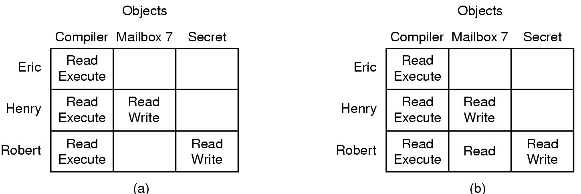
Formal Models of Secure Systems
Figure 9-12. (a) An authorized state. (b) An unauthorized state.
Tanenbaum, Modern Operating Systems 3 e, (c) 2008 Prentice-Hall, Inc. All rights reserved. 0-13-6006639

Slide 31
Multilevel Security
Most operating systems allow individual users to determine who may read and write their files and other objects. This policy is called discretionary access control.
In many environments this model works fine, but there are other environments where much tighter security is required, such as the military, corporate patent departments, and hospitals.
In the latter environments, the organization has stated rules about who can see what, and these may not be modified by individual soldiers, lawyers, or doctors, at least not without getting special permission from the boss. These environments need mandatory access controls.

Slide 32
The Bell-La Padula Model
The most widely used multilevel security model is the Bell-La Padula model (Bell and La Padula, 1973).
This model was designed for handling military security, but it is also applicable to other organizations.
In the military world, documents (objects) can have a security level, such as unclassified , confidential, secret, and top secret.
People are also assigned these levels, depending on which documents they are allowed to see.

Slide 33
The Bell-La Padula Model (1)
Rules for the Bell-La Padula model:
The simple security property: A process running at security level k can read only objects at its level or lower.
The * property: A process running at security level k can write only objects at its level or higher.
Roughly summarized, processes can read down and write up, but not the reverse.
If the system rigorously enforces these two properties, it can be shown that no information can leak out from a higher security level to a lower one.
Tanenbaum, Modern Operating Systems 3 e, (c) 2008 Prentice-Hall, Inc. All rights reserved. 0-13-6006639

Slide 34
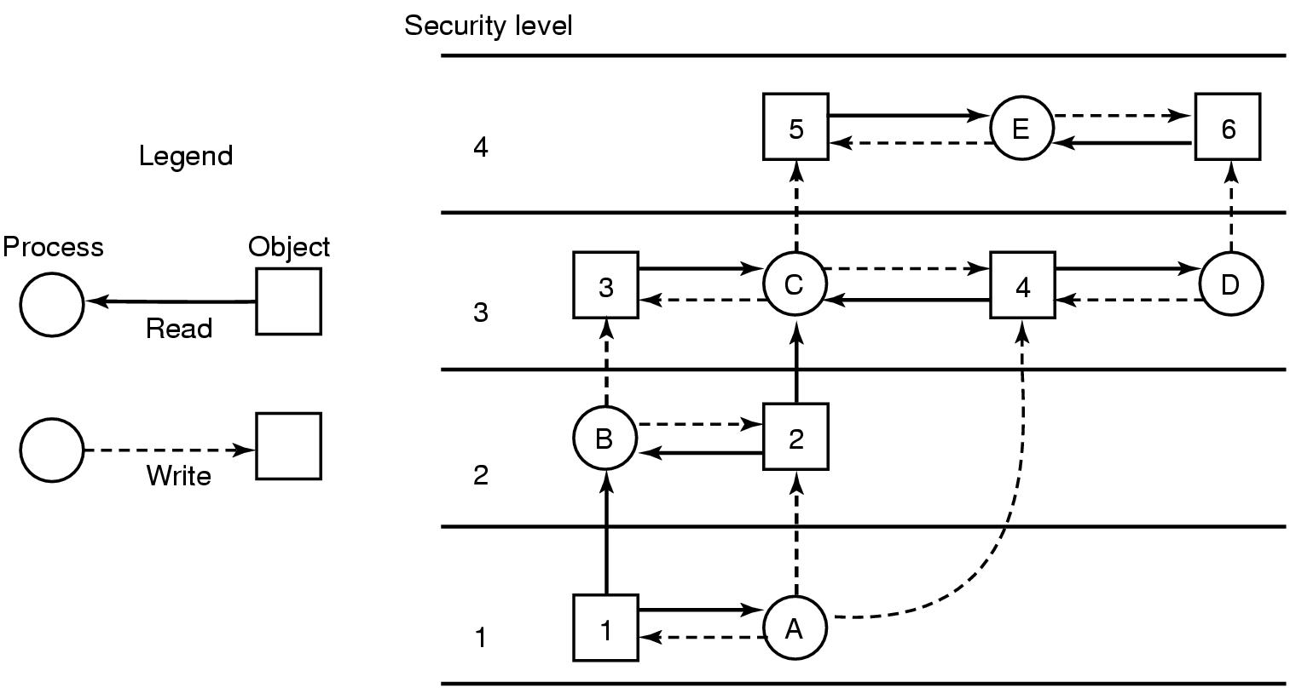
The Bell-La Padula Model (2)
Figure 9-13. The Bell-La Padula multilevel security model.
Tanenbaum, Modern Operating Systems 3 e, (c) 2008 Prentice-Hall, Inc. All rights reserved. 0-13-6006639

Slide 35
The Biba Model
The problem with the Bell-La Padula model is that it was devised to keep secrets, not guarantee the integrity of the data. To guarantee the integrity of the data, we need precisely the reverse properties (Biba, 1977):
Rules for the Biba model:
The simple integrity principle: A process running at security level k can write only objects at its level or lower (no write up).
The integrity * property: A process running at security level k can read only objects at its level or higher (no read down).
Tanenbaum, Modern Operating Systems 3 e, (c) 2008 Prentice-Hall, Inc. All rights reserved. 0-13-6006639

Slide 36
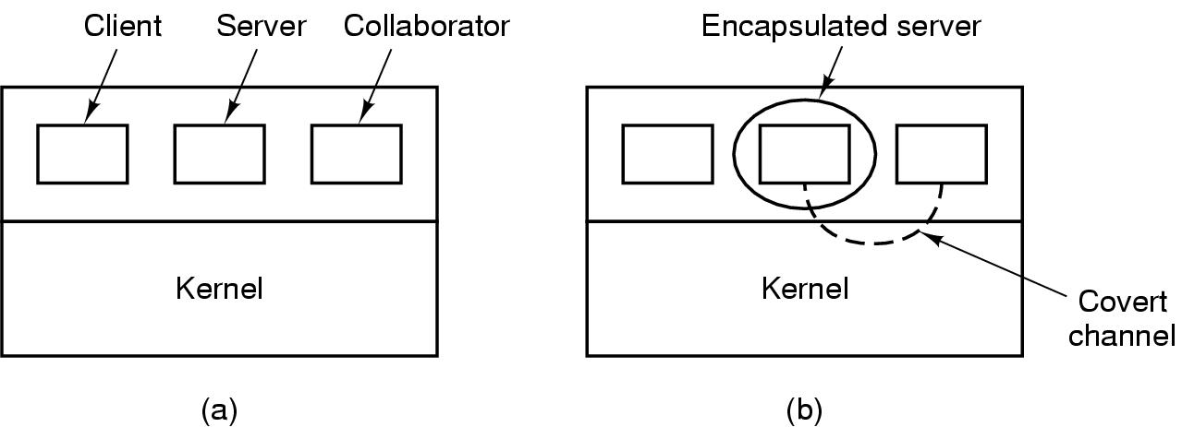
Covert Channels (1)
Figure 9-14. (a) The client, server, and collaborator processes. (b) The encapsulated server can still leak to the collaborator via covert channels.
Tanenbaum, Modern Operating Systems 3 e, (c) 2008 Prentice-Hall, Inc. All rights reserved. 0-13-6006639

Slide 37
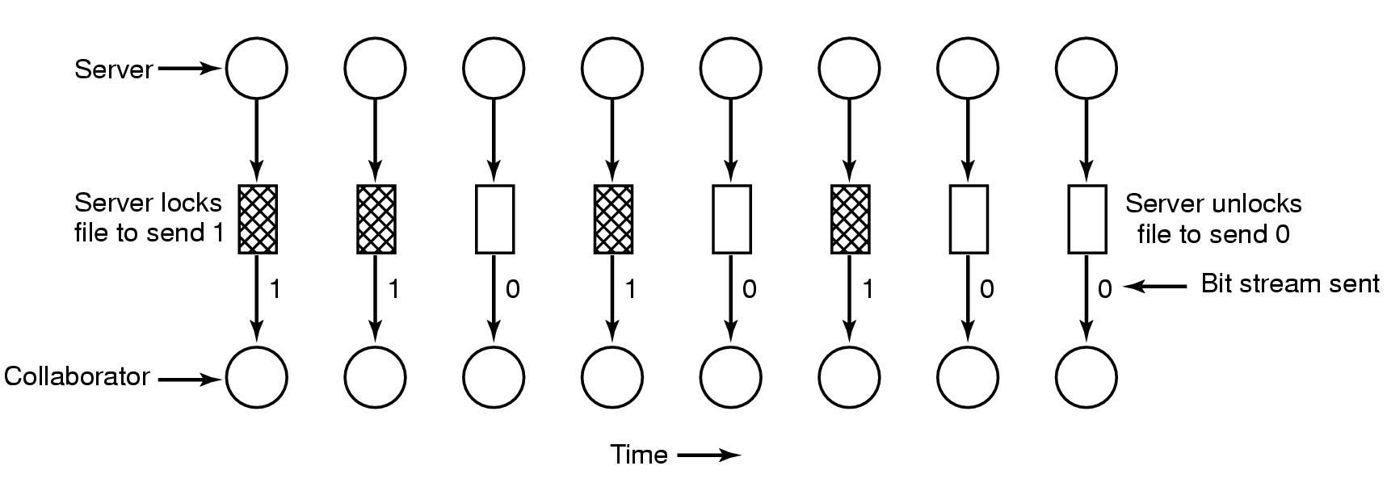
Covert Channels (2)
Figure 9-15. A covert channel using file locking.
Tanenbaum, Modern Operating Systems 3 e, (c) 2008 Prentice-Hall, Inc. All rights reserved. 0-13-6006639

Slide 38
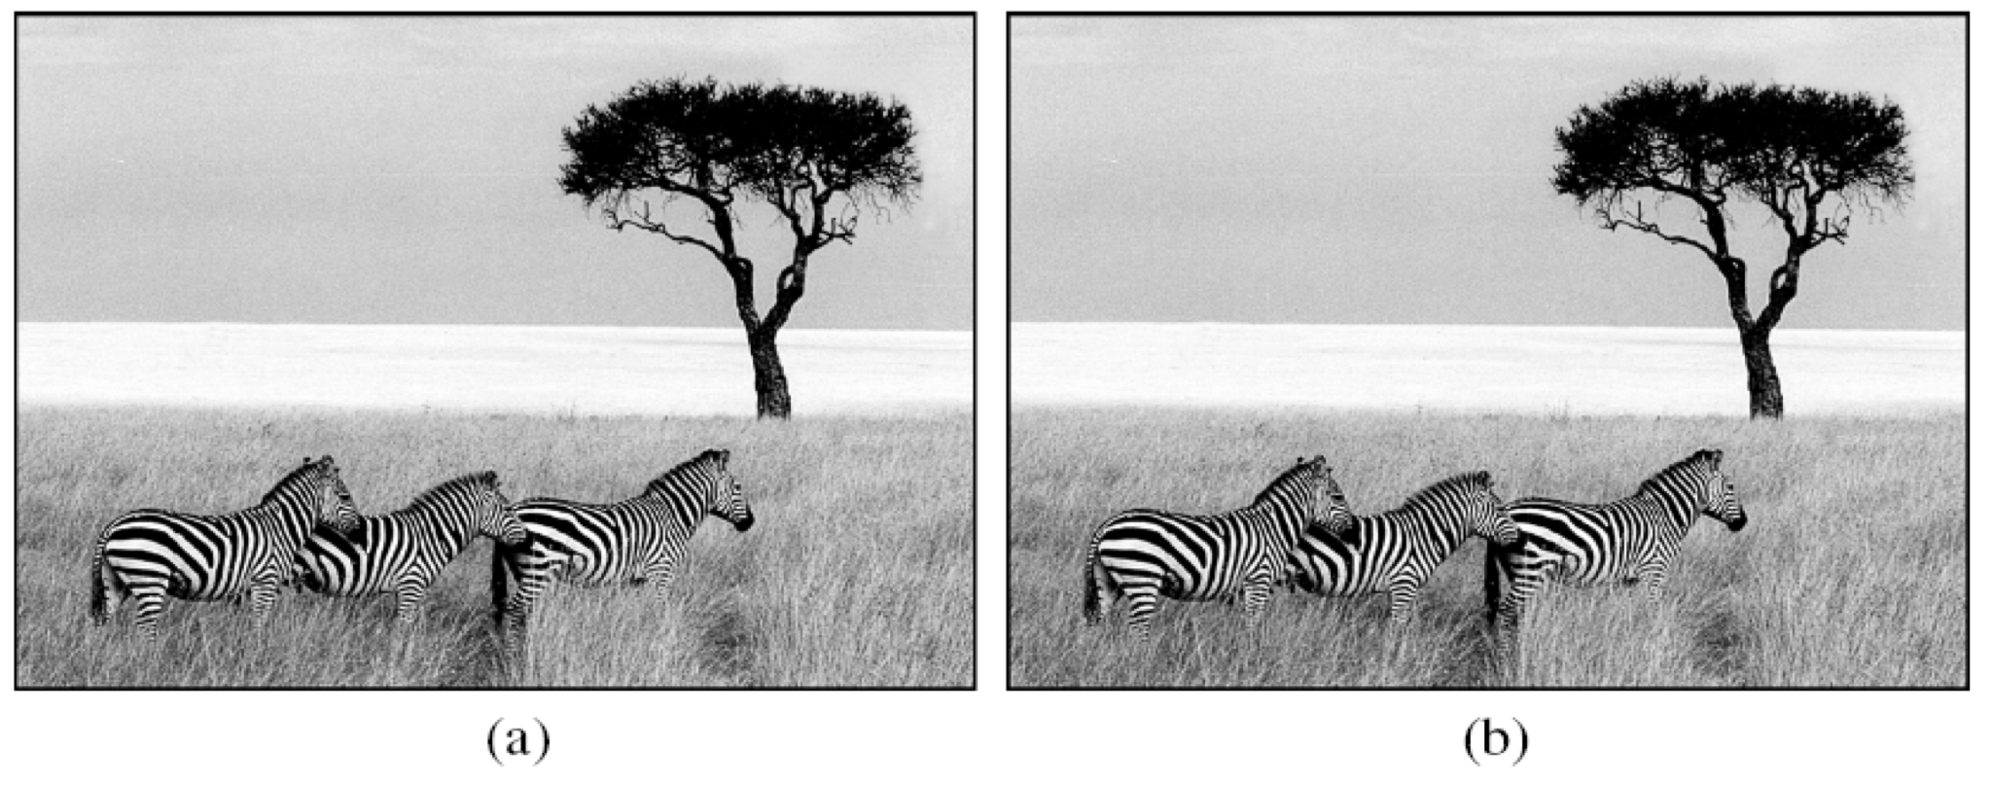
Covert Channels (3)
Figure 9-16. (a) Three zebras and a tree. (b) Three zebras, a tree, and the complete text of five plays by William Shakespeare.
Tanenbaum, Modern Operating Systems 3 e, (c) 2008 Prentice-Hall, Inc. All rights reserved. 0-13-6006639

Slide 39
The original color image is 1024 x 768 pixels. Each pixel consists of three 8-bit numbers, one each for the red, green, and blue intensity of that pixel. The pixel's color is formed by the linear superposition of the three colors. The encoding method uses the low-order bit of each RGB color value as a covert channel. Thus each pixel has room for 3 bits of secret information, one in the red value, one in the green value, and one in the blue value. With an image of this size, up to 1024 x 768 x 3 bits (294,912 bytes) of secret information can be stored in it. The full text of the five plays and a short notice adds up to 734,891 bytes. This was first compressed to about 274 KB using a standard compression algorithm. The compressed output was then encrypted and inserted into the low-order bits of each color value.

